Slide 1

XAI-ASSISTED DEEP LEARNING MODELS FOR TRUSTWORTHY
PREDICTION OF PNEUMONIA USING CHEST X-RAY IMAGES
Presented By
Supervised By
Dr. Ashok Kumar Bhoi
(Assistant Professor)
Rohan Behera
Regd.No(2101110062)
Aditi Mishra
Regd.No(2101110022)
Ankit Verma
Regd.No(2101110031)
Aparna Choudhury
Regd.No (2101110033)
Government College of Engineering Kalahandi, Bhawanipatna-766002
Date 03-02-2025

Slide 2
Outlines
Introduction
Problem Statement
Objectives
System Framework
Progression
Algorithm
Conclusion

Slide 3
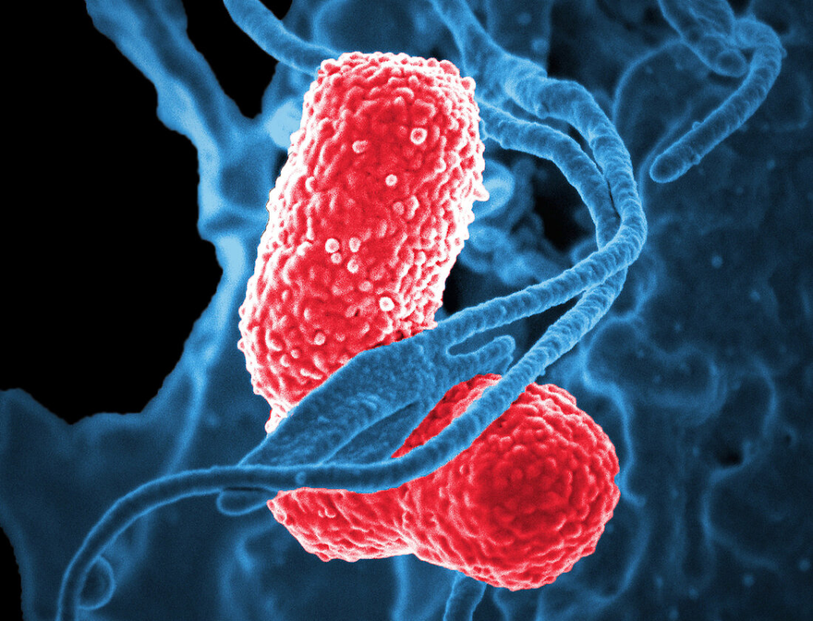
INTRODUCTION
Pneumonia is a common and potentially life-threatening respiratory infection, and early and accurate diagnosis is crucial.
Chest X-ray imaging is a primary diagnostic tool for pneumonia, and the integration of ML and DL has significantly improved the speed and accuracy of pneumonia detection.
However, these models are often complex and their decision-making processes can be difficult to understand, which is why there is a pressing need for interpretable artificial intelligence

Slide 4
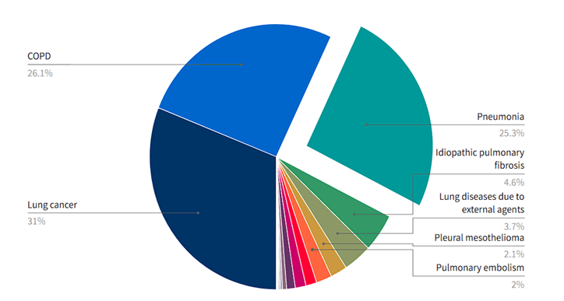
PROBLEM STATEMENTS
To evaluate existing deep learning models for pneumonia prediction using chest x-ray images
To incorporate X-AI technique in deep learning models for trustworthy prediction of pneumonia using chest x-ray images

Slide 5





OBJECTIVES
Integrating Explainable AI (XAI)
Enhancing model transparency and interpretability by incorporating Explainable AI (XAI) techniques, ensuring trust, accountability, and better decision-making.
Data Collection & Deep Learning Model Training
Dataset Incrementation
Collecting and pre-processing data to train deep learning models for accurate analysis, pattern recognition, and decision-making.
Expanding the dataset incrementally to improve model performance, enhance generalization, and adapt to new patterns over time.

Slide 6
SYSTEM FRAMEWORK
Scope Project
Collect Data
Train Model
Model Evaluation
Quick-shift
Output
X-AI Implementation (LIME
SLIC
Quick-shift with Noise
FIG 1: System framework for X-AI based pneumonia prediction

Slide 7
DEEP LEARNING MODELS FOR PNEUMONIA PREDICTION
CNN Methods | Training Accuracy | Training Accuracy | Training Loss | Training Loss | Test Accuracy | Test Accuracy | Test Loss | Test Loss | Validation Accuracy | Validation Accuracy | Validation Loss | Validation Loss
 | OLD | NEW | OLD | NEW | OLD | NEW | OLD | NEW | OLD | NEW | OLD | NEW
VGG16 | 94.92% | 96.47% | 0.1367 | 0.0935 | 93.85% | 96.94% | 0.1516 | 0.0887 | 93.84% | 95.96% | 0.1601 | 0.1065
INCEPTION | 95.74% | 97.93% | 0.0977 | 0.0666 | 93.51% | 98.66% | 0.2695 | 0.0732 | 92.88% | 96.57% | 0.2220 | 0.1088
SPINAL | 94.15% | 94.93% | 0.1593 | 0.144 | 92.49% | 95.77% | 0.2205 | 0.1491 | 92.20% | 94.35% | 0.2080 | 0.166

Slide 8
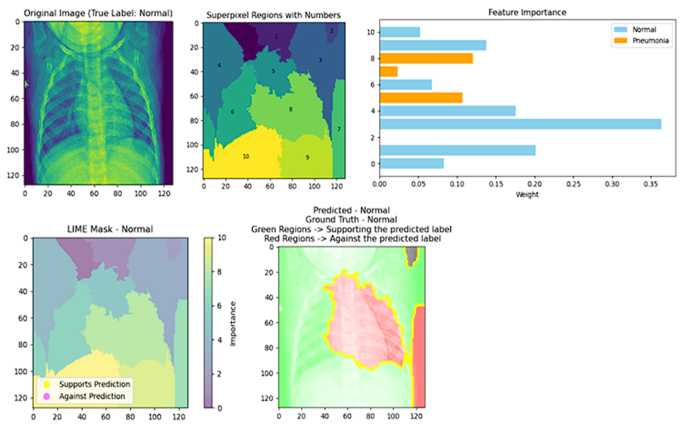
Algorithm-1: SLIC
Pick Initial Centers – Select points on the image at equal distances.
Adjust Centers – Move them slightly to areas with less change in brightness.
Assign Pixels – Group nearby pixels based on color and location.
Update Centers – Move each center to the average position of its assigned pixels.
Repeat Until Stable – Keep refining until centers stop changing.
Ensure Connectivity – Fix any disconnected regions for smooth superpixels.

Slide 9
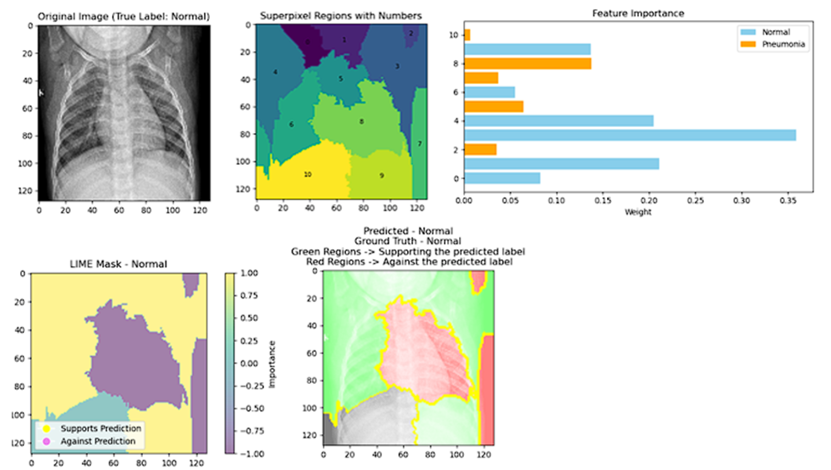
Algorithm-2: QUICKSHIFT
Input:
An image to process.
A size parameter (r) that controls how big each group (superpixel) should be.
Optional settings like how smooth the boundaries should be and how far to search for similar pixels.
Pick Starting Points – Choose spots in the image to start forming groups.
Group Nearby Pixels – Each starting point gathers nearby pixels based on color and distance.
Update Centers – Adjust the center of each group based on the assigned pixels.
Check for Stability – Repeat steps 2-3 until groups stop changing much.
Fix Small Gaps – Ensure each group is a smooth, connected region.

Slide 10
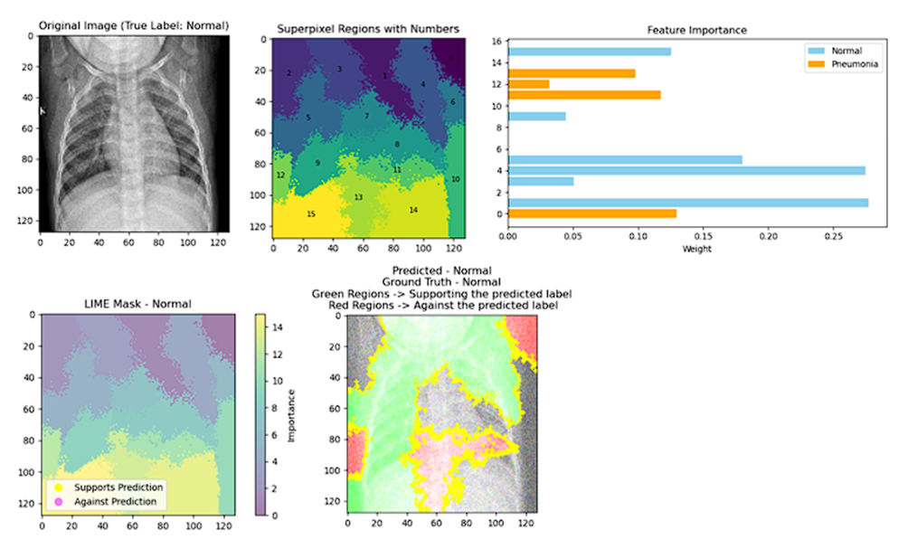
Algorithm-3: QUICKSHIFT WITH NOISE
1. Initialization with Noise: Start by initializing cluster centres. Instead of placing them precisely on a regular grid, introduce noise by perturbing the initial positions randomly.
2. Repeat the following steps until convergence:
- For each cluster centre (Ck):
- Assign pixels to cluster based on a distance measure, considering its spatial info.
- Update the cluster centre by computing the mean position of the assigned pixels.
3. Convergence Check:- Check for convergence by monitoring changes in cluster centres or other convergence criteria.
4. Enforce Connectivity:- After convergence, enforce connectivity to ensure that the segmented regions form coherent structures.

Slide 11
CONCLUSION
In conclusion, pneumonia is a severe respiratory infection that requires early and accurate diagnosis for effective treatment. This project leverages deep learning models integrated with Explainable AI (XAI) techniques to enhance pneumonia prediction. So far “INCEPTION” turns outs to be the best model with an Accuracy of 95.74%.The use of XAI not only improves model transparency but also aids in identifying critical image regions and key features, providing better interpretability for medical professionals. By combining deep learning with explain ability, this approach contributes to more reliable and insightful pneumonia diagnosis, ultimately supporting improved clinical decision-making.
THANK YOU

